Slide 1
Investigating Teen Comfort and Engagement Using Nao
Harmehak Singh Khangura
Department of electrical and computer engineering
University of waterloo

Slide 2
Overview
Motivation
Related Work
Research Questions
Method & Study Design
Results
Discussion
Conclusion & Future Work

Slide 3
Motivation
Why do we need to study Adolescent-Robot Interaction?
Adolescence is a critical development stage for humans.
Robots can serve as educational tutors and mentors for students.
Social Robots could aid in offering non- judgmental support for anxiety and depression.

Slide 4
Motivation (Cont.)
Research Gap
Much work on adult-robot interaction, less on adolescent – robot context.
Opportunity to refine robot design for youth-centered applications.
Lack of detailed data on approach speed, stopping distance and gesture speed.

Slide 5
Related Work
Impact of Nonverbal Behaviors: Numerous studies in Human-Robot Interaction emphasize that nonverbal cues such as waving, nodding or maintaining direct eye gaze significantly influence how people perceive a robot’s friendliness and intent. Research indicates that consistent, recognizable gestures can increase trust and reduce anxiety during initial interactions.
Humanlike vs. Robot-Specific Actions: In research comparing humanlike gestures (e.g., subtle head nods, hand waves that mirror human motion) and robot-specific gestures, humanlike behaviors often evoke greater perceived warmth and empathy. However, properly designed robot-specific behaviors have also been shown to foster positive responses if they are consistent, predictable, and appropriately timed.
Contextual and Cultural Factors: Researchers highlight that acceptance and comfort can vary according to cultural norms regarding touch, interpersonal distance and social manners. Robots operating in cross-cultural environments should be programmed with adaptive strategies that accommodate diverse expectations for personal space, gesture speed, and greeting customs.

Slide 6
Research Questions
Q1. How does stopping distance affect an adolescent’s comfort level when a robot approaches?
Q2. Does a basic wave gesture increase teens perceived friendliness or approachability?
Q3. Are slow, deliberate motions perceived as more reassuring and less threatening than abrupt or rapid movements in adolescent populations?

Slide 7
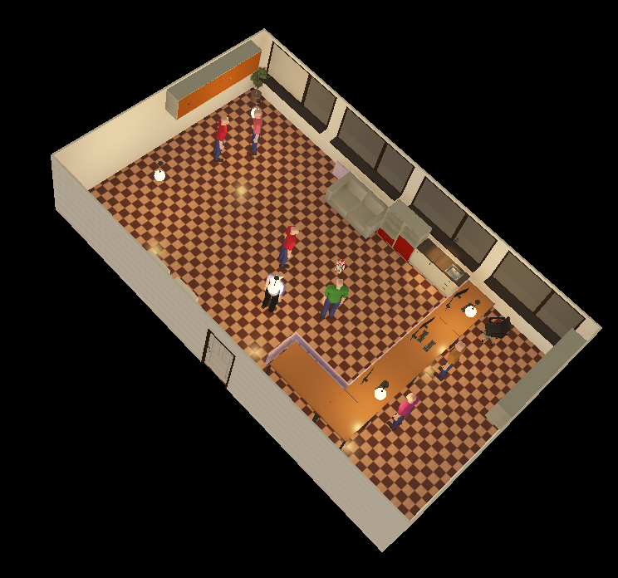
Study design
Within-Subjects Experimental Setup was used.
Webots simulation environment.
Nao robot performing a fixed gesture sequence
Four different scenarios were used:
Video 1 - Slow approach speed + optimal distance + slow gestures
Video 2 - Slow approach speed + close distance + slow gestures
Video 3 - Fast approach speed + optimal distance + fast gestures
Video 4 - Fast approach speed + close distance + fast gestures

Slide 8
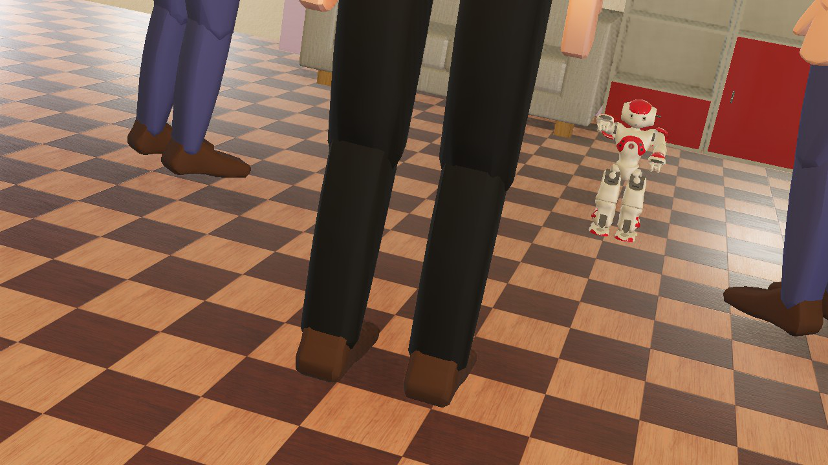

Simulation

Slide 9
Procedures & Measures
Each session was about 15–20 mins.
10 participants watches 4 short videos (30–60 seconds each) in a random order.
Post-video surveys Using Google Form
Comfort, Perceived Friendliness, Positive Engagement Intent, Approachability, Relaxation/Tension

Slide 10
Questionnaire
How comfortable did you feel when the robot approached you in this video?
How friendly did the robot seem?
Did you feel like the robot was trying to engage with you in a positive way?
Did the robot's wave, attentive and nod gestures make it feel more approachable?
How relaxed or tensed you felt when robot approached you?

Slide 11
Results
Highest comfort and approachability in slow approach + optimal distance scenario
Significantly lower comfort/tension in fast approaches, especially with close distance
Friendly gestures overshadowed by rapid approaching speed

Slide 12
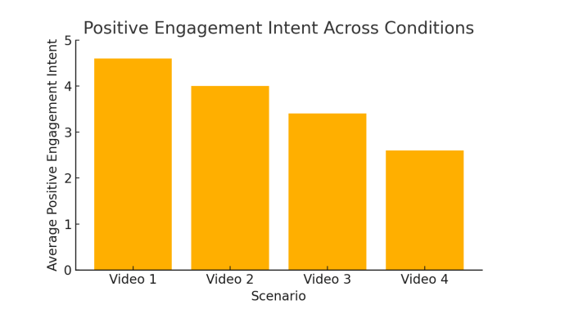
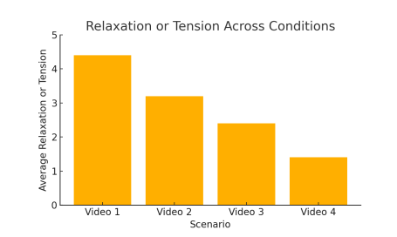
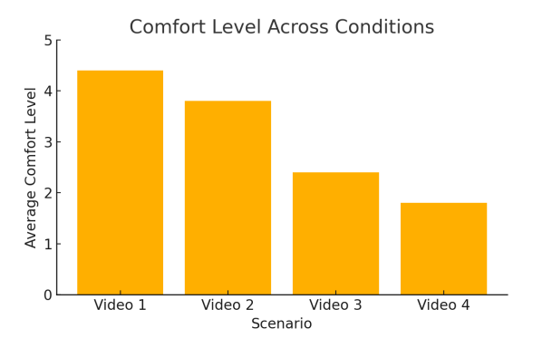
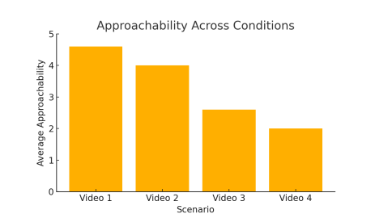
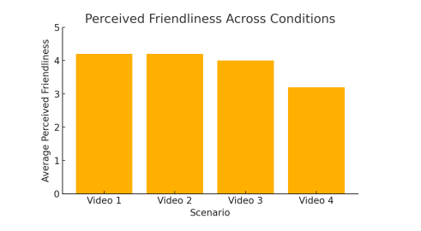
Results (Graphs)

Slide 13
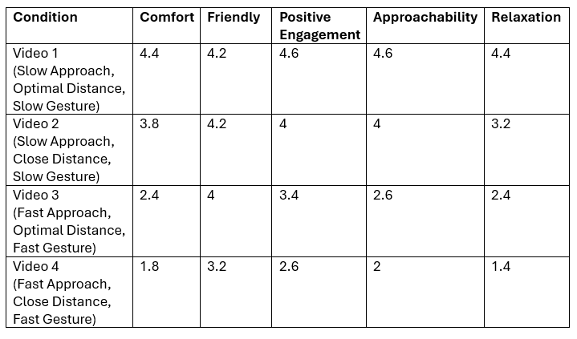
Results(Cont.)

Slide 14
Discussion
Results suggest that developers should prioritize predictable, measured movement patterns in youth-focused robotics.
Slower approach speeds, stopping at optimal distances significantly increased comfort and relaxation levels. Fast approach speeds combined with a close stopping distance, increases anxiety and reduced approachability.
Friendly gestures (wave, nod, shy gesture) help the robot appear social, their positive impact diminishes if adolescents perceive an invasion of personal space or an abrupt motion.

Slide 15
Conclusion
Balancing speed, distance and gesture speed is essential for positive adolescent-robot interaction.
Adolescents may be more sensitive to sudden or invasive movements.
Simulation results suggest slower, more measured approaches are best for building trust.

Slide 16
Future Work
Live user testing with real adolescent participants.
Larger and more diverse sample populations.
Adaptive robots that sense and respond to user anxiety.

Slide 17
acknowledgement
I want to express my deepest gratitude to our instructor Professor Kerstin Dautenhahn and our TA Pourya Aliasghari for their constant support during this course.

Slide 18
THANK YOU

